Slide 1


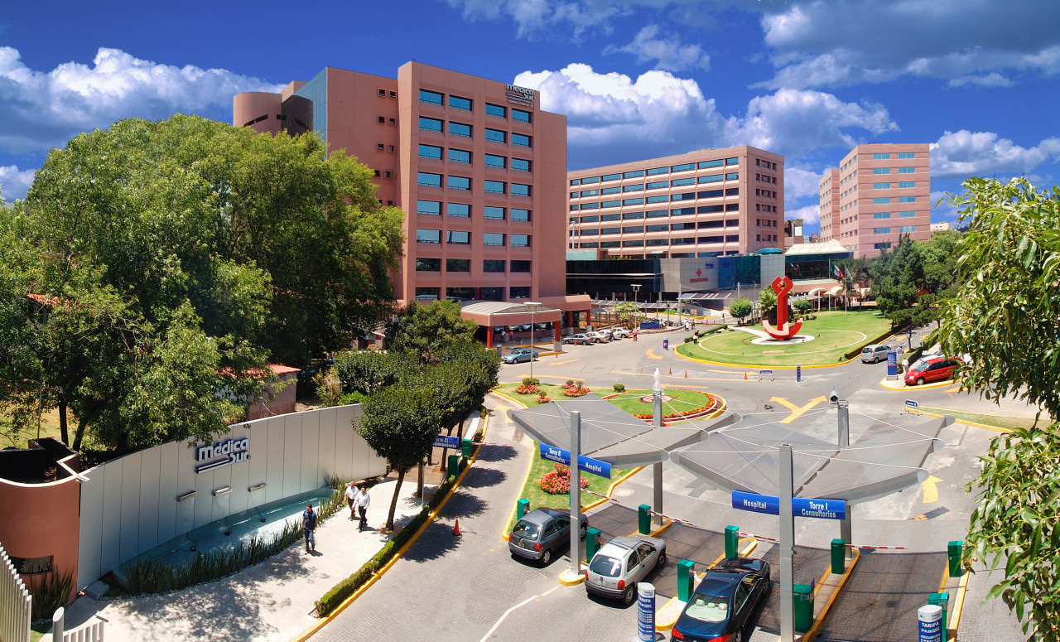
Misael Uribe
LOS GRANDES PROBLEMAS QUE YA NOS ALCANZARON
Sesión del 4 de Octubre
Neurología , problemas crónico degenerativos
Julio Sotelo
Sindrome metabolico
Misael Uribe
Envejecimiento
María del Carmen García
Solución genómica?
Xavier Soberón
Comenta Alberto Fratti
Tribuna
Notes:
1

Slide 2
Misael Uribe M.D.,Ph.D
.Hígado graso, obesidad, síndrome métabolico
Notes:
2

Slide 3
Costo de problems globales en billones USAD.
Tabaquismo 2.1
Violencia, guerras 2.1
Obesidad 2.0
Alcoholismo1.4
Analfabetismo 1.3

Slide 4
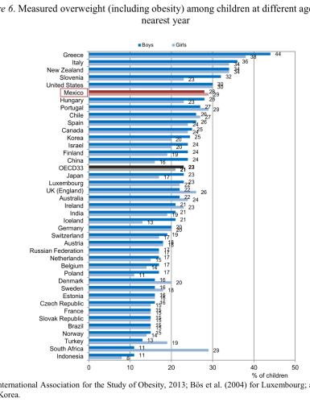

Slide 5
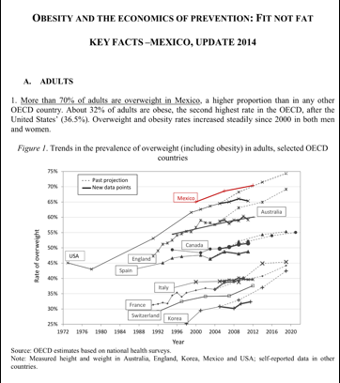

Slide 6
Definición
IDF (2005)
Obesidad abdominal*
  Cintura > 94 cm en hombres
  Cintura > 80 cm en mujeres
Más 2 de los siguientes:
Glucemia plasmática en ayunas > 100 mg/dl o tto
Tensión arterial > 130/85 mmHg o tto
Triglicéridos > 150 mg/dl o tto
HDL-colesterol o tto
  < 40 mg/dl en hombres
  < 50 mg/dl en mujeres
* variable según etnia

Slide 7
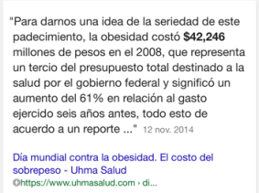

Slide 8
COMPLICACIONES DE LA OBESIDAD (letales en amarillo)
Dislipidemia
Osteoporosis
Diabetes
Mellitus
Reflujo
Litiasis
vesicular
Esteatosis
Hepática
Esteatohepatitis
Cirrrosis
OBESIDAD
Ovarios
Poliquísticos
Enfermedad
Cardiovascular
Hipertensión Arterial
Cáncer

Slide 9
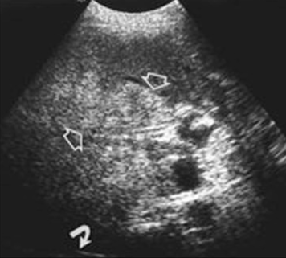
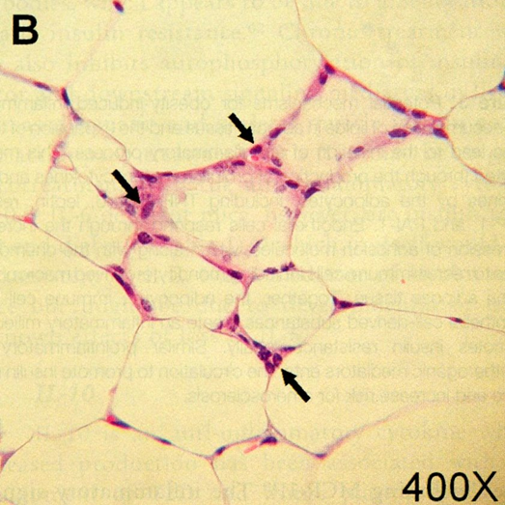
Hígado graso no alcohólico
Obesidad, S.Metabolico y Resistencia a la Insulina.
Un ejemplo de involución
Misael Uribe
Fundación clinica
Medica sur,Afiliada a UNAM.
Siegelman ES Semin Liver Dis 2001;21(1):71-80

Slide 10
Historia natural de la esteato hepatitis no alcohólica?

Slide 11
?

Slide 12

Que cambio desde 1970?
En 1970 la mayoría de la poblacion no era obesa.
En 2017 la obesidad es epidemica!
Que es tan diferente ahora?
Reducira la esperanza de vida?, Arruinara
  Los sistemas de salud?
Notes:
How does this new knowledge fit in with the obesity epidemic?

Slide 13
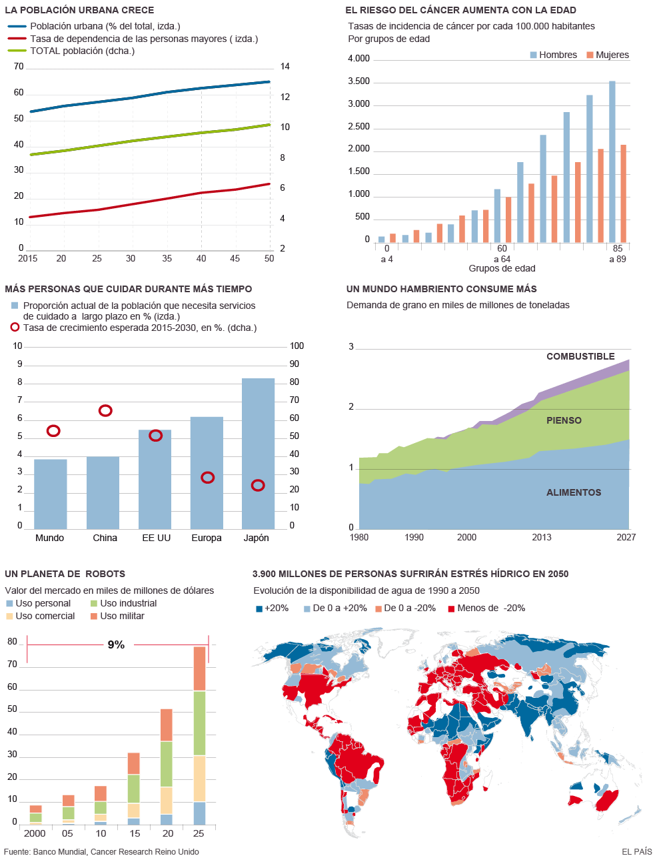


Slide 14
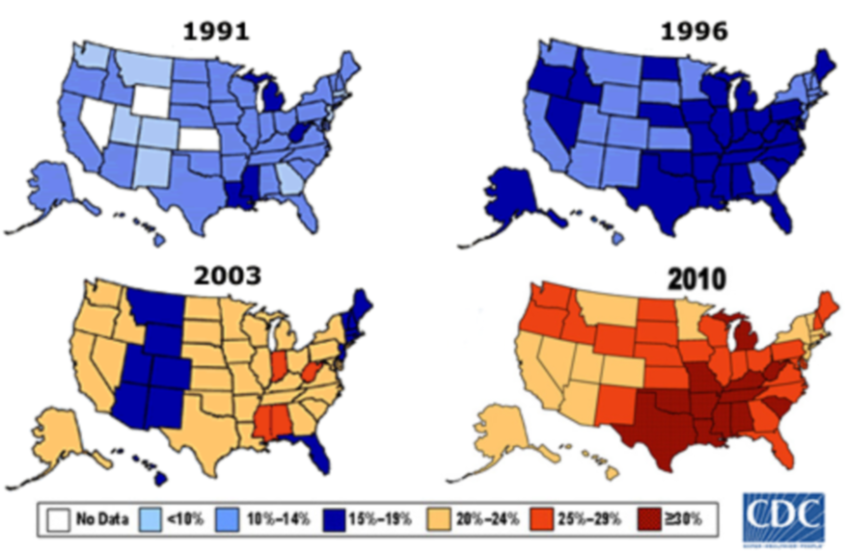
USA CAMBIOS MUY RAPIDOS

Slide 15

Además de nuestro Genoma
Somos lo que comemos
Cambios exógenos

Slide 16
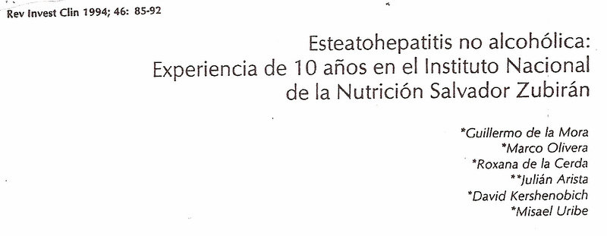
Facing two related epidemics: DM-CVD…NASH-Cirrhosis-HCC
Evolutions :
In 1994 18 cases of NASH were found in over 2000 Liver biopsies :
In only 7 cases an evolution to cirrhosis was found.
In 2008 , NAFLD and NASH are the most common cause of liver consultation.

Slide 17
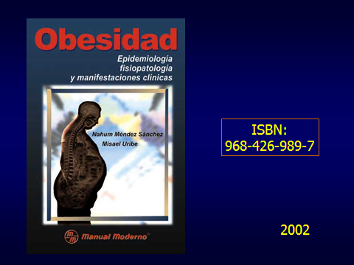
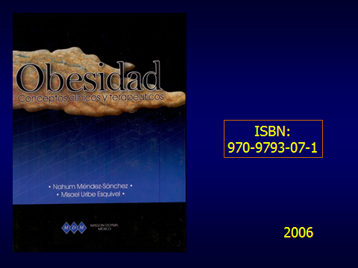



Slide 18

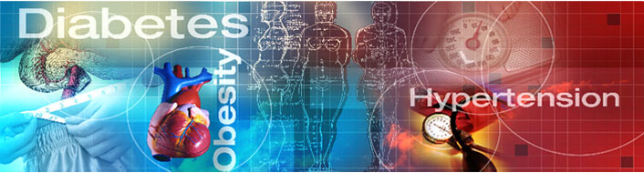
Obesity
Endothelial dysfunction
Inflammation
NASH
Insulin
resistance

Slide 19
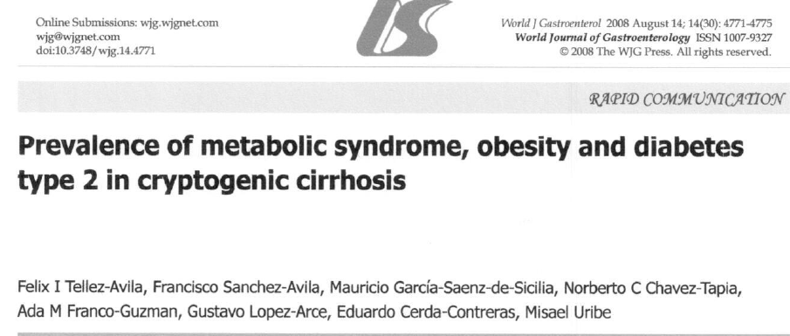

Slide 20
Hyperglycemia*
Hypertension*
Dysfibrinolysis
Insulin
Resistance
Intolerancia
a la glucose*
Polycystic
ovary
NASH*
Dislipidaemia*
Obesity*IMC>30
Endothelial
Dysfunction
Nutrition Metabolism and Cardio Vascular Diseases 2010 20: 140-46*

Slide 21
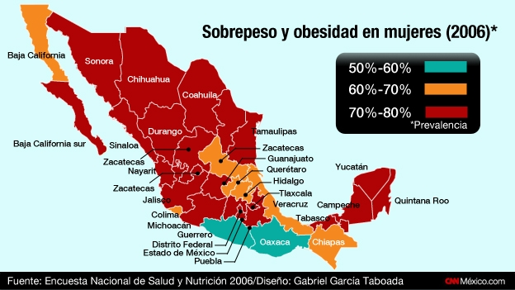

Slide 22
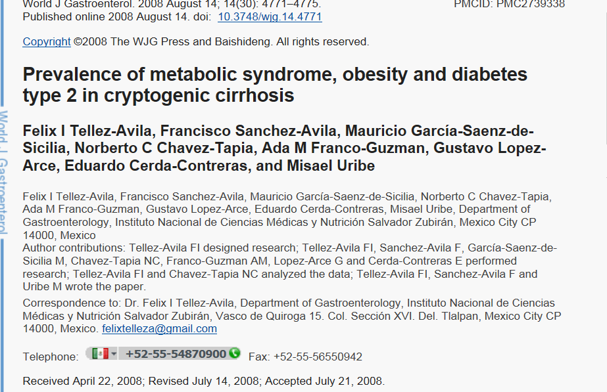
AETIOLOLOGY OF CC?
Cirrhosis
Known
Aetiology
Cirrhosis
Cryptogenic
10/30%
Non aetiology
Previosly
found
0besity……%8
MS………..%6
T2DM……..%22
0besity…..16.4%
MS……….29%
T2DM…..40.6%
Obesity
Metabolic Syndrome
T2DM
Data suggest
that MS
Leads to
cryptogenic
cirrhosis

Slide 23
Riesgo asociado al síndrome metabólico. Curvas de riesgo Kaplan-Meier (no ajusadas)
Mortalidad por enfermedad
coronaria
Mortalidad por enfermedad
cardiovascular
Mortalidad debido a todas
las causas
20
PR (95% CI),
3.77 (1.74-8.17)
20
PR (95% CI),
3.55 (1.96-6.43)
20
PR (95% CI),
2.43 (1.64-3.61)
15
15
15
Sindrome Metabólico
Riesgo acumulado, %
si
no
10
10
10
5
5
5
0
0
0
0
2
4
6
8
10
12
0
2
4
6
8
10
12
0
2
4
6
8
10
12
No. en Riesgo
SM
Seguimiento en años
Seguimiento en años
Seguimiento en años
Si
No
866
288
852
279
834
234
292
100
866
288
852
279
834
234
292
100
866
288
852
279
834
234
292
100
Lakka HM et al. JAMA. 2002;288:2709-2716.

Slide 24
Relative Risk of Mortality, CHD, and Type 2 Diabetes According to BMI
Relative Risk of:
Mortality
CHD
Diabetes
2.0
1.5
1.0
0.5
0.0
4.0
3.0
2.0
1.0
0.0
8
6
4
2
0
<19.0
>32.0
<21.0
>29.0
<22.0
>35.0
BMI (kg/m²)
BMI (kg/m²)
BMI (kg/m²)
Manson JE, et al. N Engl J Med. 1995;333:677–685; Willett WC, et al. JAMA. 1995;273:461–465; Colditz GA, et al. Ann Intern Med. 1995;122:481–486.

Slide 25
Costos de la Obesidad
300,000 muertes por año.
En USA.
2a. causa de muerte por enfermedad prevenible.
Asociada a enfermedad no digestiva y digestiva.
127 millones tienen sobrepeso.
60 millones son obesos.
El costo actual entre 40-89 mil millones de Dls.
La Obesidad es multiórganica , incluyendo morbilidad digestiva
300,000 muertes por año.
En USA.
2a. causa de muerte por enfermedad prevenible.
Asociada a enfermedad no digestiva y digestiva.
127 millones tienen sobrepeso.
60 millones son obesos.
El costo actual entre 40-89 mil millones de Dls.
La Obesidad es multiórganica , incluyendo morbilidad digestiva
En México cerca del 30% de la población es Obesa.
Algunas enfermedades digestivas:
  Colelitiasis-colecistitis.
  Esteato hepatitis no alcohólica.
  IMC y RGE asociados.
  Pancreatitis (>litiasis, cáncer)
  Colon Irritable.
  Cáncer de Colon

Slide 26
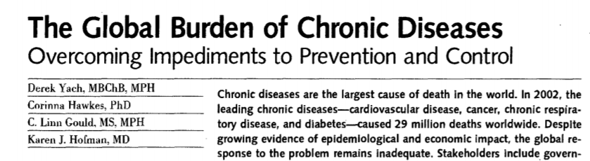

Slide 27
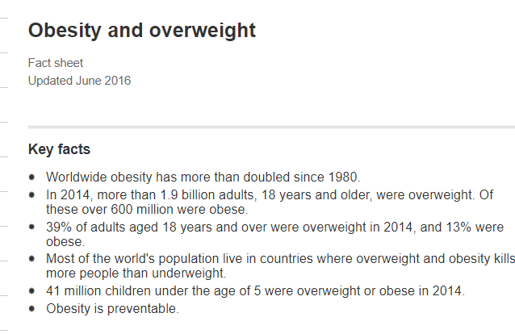

Slide 28


El mejor tratamiento: ejercicio y dieta
con poca azúcar, verduras, pescado
+
Desafortunadamente la mayoría abandona y deserta!!!

Slide 29
Adipokines and fatty liver

Slide 30
El futuro nos alcanza
Unless effective population level
interventions to reduce obesity
are developed , the steadly rise
in life expectancy observed in
the modern era, soon may come to
an end,
NEJM 352;11,05

Slide 31
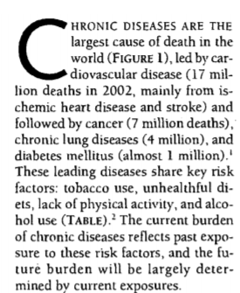

Slide 32
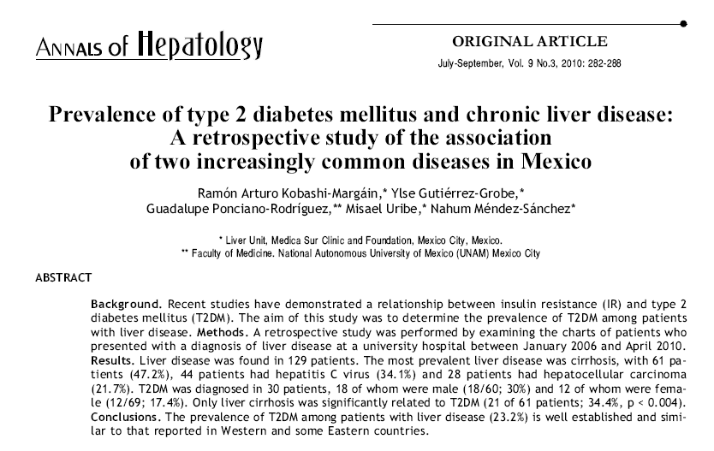
México
2010: LC
And T2D
Occurs in 34.4%

Slide 33
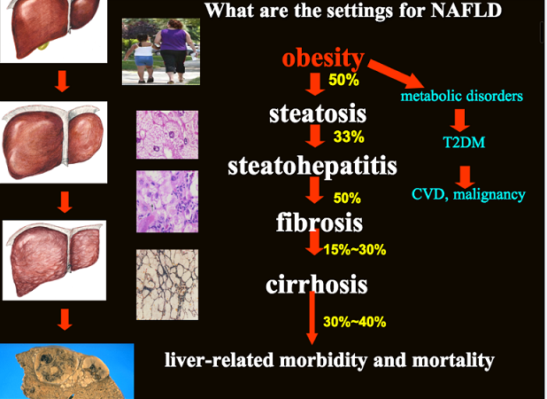
An hepatologist view of the same
problem, but affecting the liver

Slide 34
Obesity
Endothelial dysfunction
Inflammation
NASH
Insulin
resistance

Slide 35
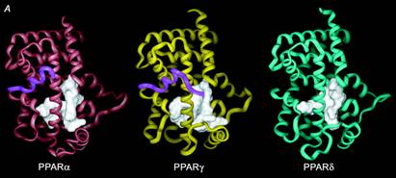
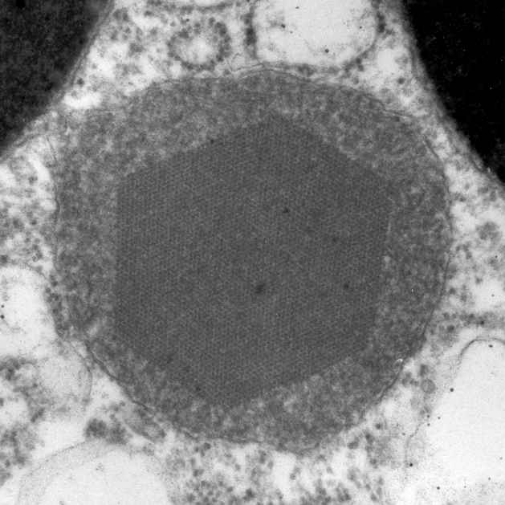
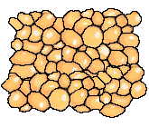
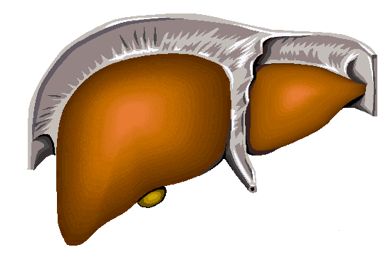
3.-Los Rrreceptores Activados de
Proliferación de
Peroxisomas PPARs juegan un papel
Básico en metabolismo de lípidos
Manejo de ROS
PPARα
PPARγ
PPARβ
Nutrientes, metabolismo lipidos β oxidación
De mas de 20C
- Proliferación
Inflamación
-metabolismo lipidos
-Control del ciclo
celular
-Inflamación
Metabolismo de
lipidos
-queratinocitos
diferenciacion
Inflamación

Slide 36
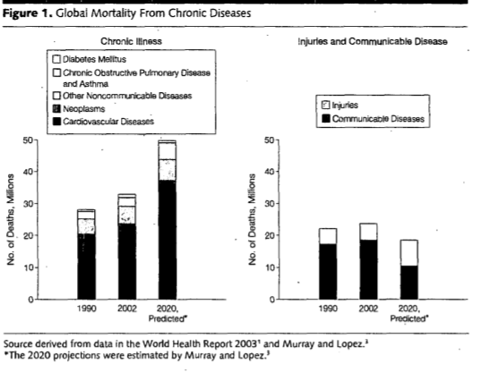

Slide 37
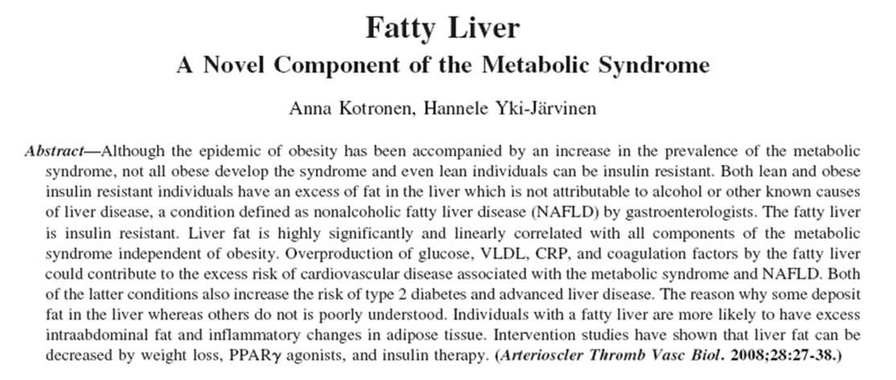
Kontronen A and Yki-Järvinen H, Arterioscler Thromb Vasc Biol 28:27-38, 2008

Slide 38
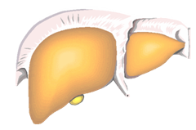
1.-Los acidos grasos libres se elevan y depositan en el hígado en la obesidad
FFA
FFA
HIGADO GRASO

Slide 39
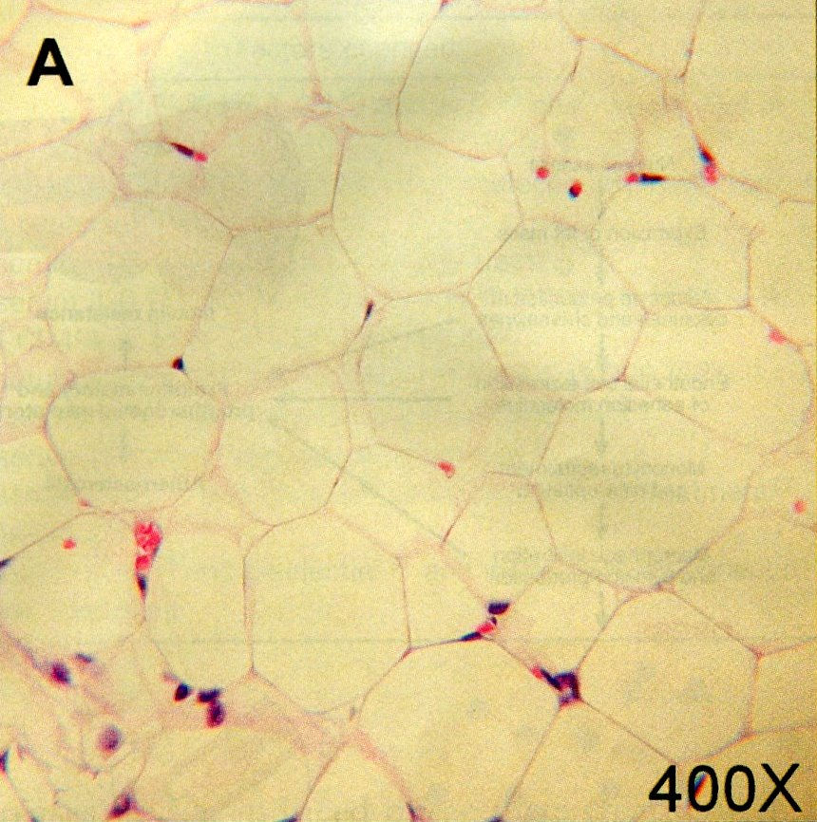

2.-Los Adipocitos son células activas, secretoras, (adipocinas), inflamados,
Con Infiltración leucocitaria.
(flechas)

Slide 40
¿La esteatohepatitis reduce la cantidad y la calidad de vida?
¿Es una enfermedad genética o adquirida?
Costos?
Su diagnóstico requiere biopsia hepática?
La epidemiología de la obesidad va de la mano de la epidemiología de la esteatohepatitis?
¿Hay un fármaco útil?
¿Existe el tratamiento ideal?

Slide 41
Obesidad y
Hepatopatía
La frecuencia de la cirrosis hepática esta aumentada en los pacientes obesos.
Obesidad >NASH >Cirrosis
La Obesidad favorece otras lesiones tales como La HVC y la EHA.
Es un problema grave de salud.

Slide 42
Endothelial Dysfunction
superoxide anion
Lipoperoxydation of
arachidonic ac.
NO
Peroxynitrite
Isoprostane F
(vasoconstrictor)
↓ Bioavility of NO
Reckelhoff. Hypertension 1999;34:943-9

Slide 43
Insulin-Resistance
Endothelial Dysfunction
Cardiovasc Res 2001; 47:457-464

Slide 44
Steatosis patients had significantly lower concentrations of adiponectin
And higher concentrations of leptin

Slide 45
Recent data have suggested that
Macrophage also play an essential
Role in suppressing Inflammation and
initiating wound repair
Annu. Rev. Pharmacol. Toxicol 2011. 51: 267-88

Slide 46
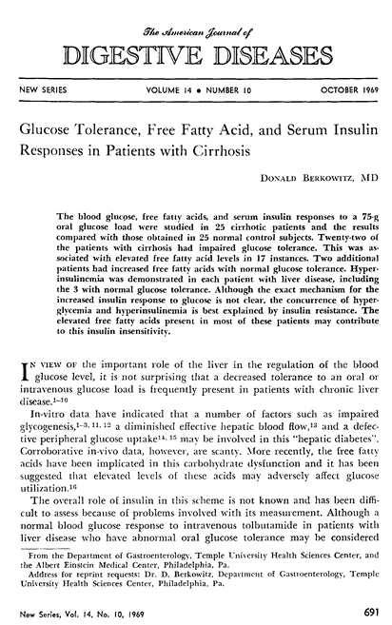
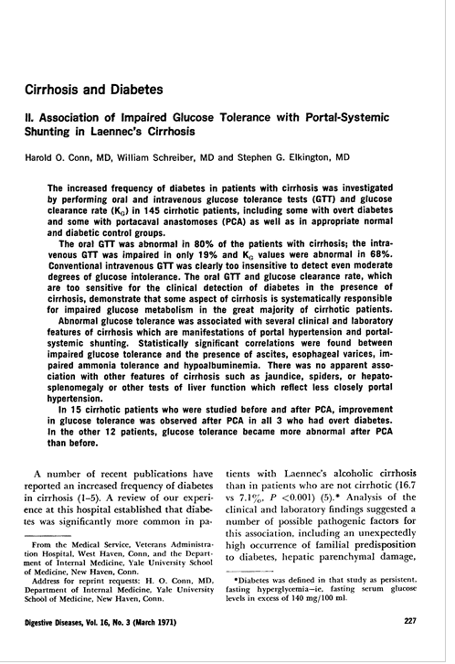
Pioonering studies
Concepts
First
CH+Glucose
Intolerance
Insulin
Resistance
Normal glucose
Levels<140mg

Slide 47
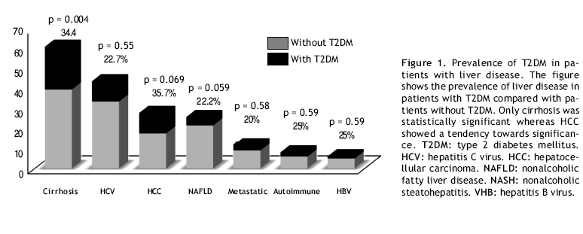
FREQUENCY OF DMT2 IN DIVERSE HEPATIC LIVER DISEASES
Two sources of Cirrhosis connected
NASH and Type C viral infection

Slide 48
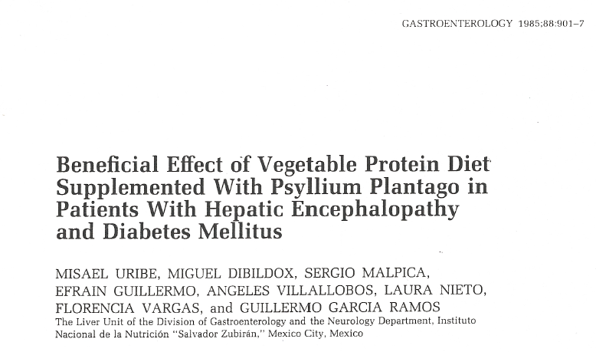
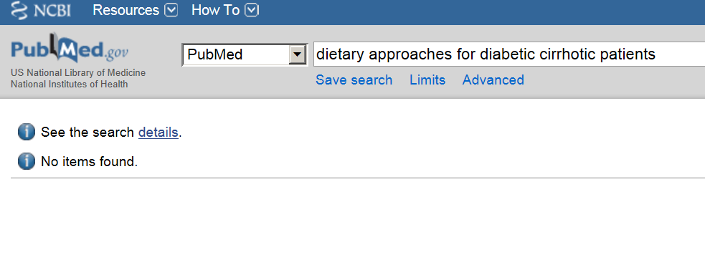
Very few attempts to use a dietary
treatment for cirrhosis –diabetics in 30years!
An old study, but not yet challenged.

Slide 49
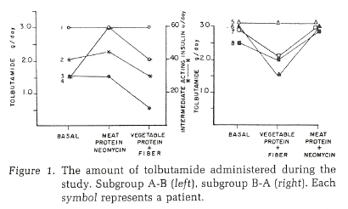
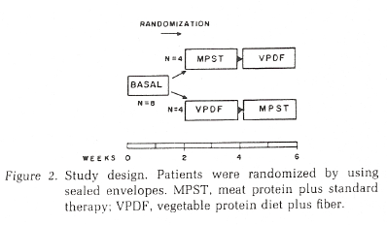
CCO study
8 patients , 4 first Standard meat Diet and therapy,
4 first Vegetable,
Rich in fiber, then crossover
Lower glucose levels with
VPD+fiber
Control of hepatic
encephalopathy
No further studies PERFORMED
A niche of opportunity

Slide 50
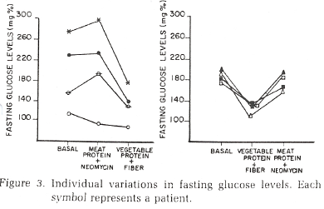
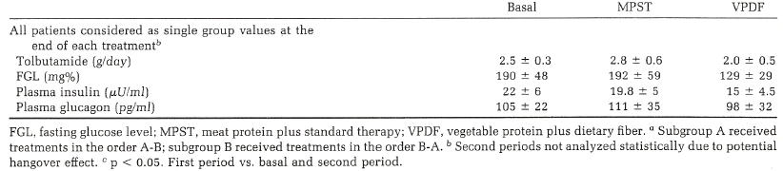
Glucose levels in 4-4 cirrhotic diabetic patients
Vegetable protein diets better to control encephalopathy
and glucose levels in cirrhotic diabetic patients!!!!!

Slide 51
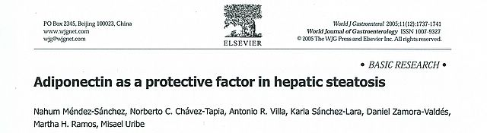
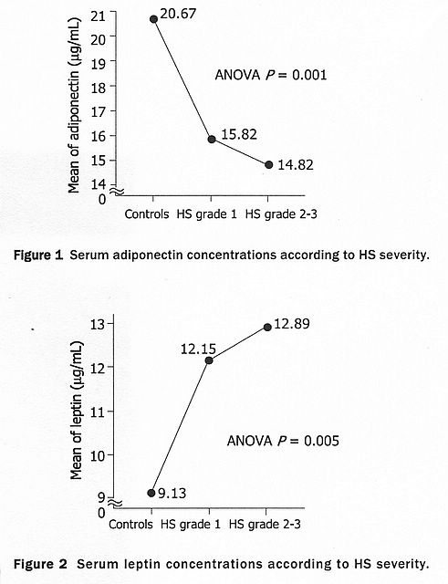
Results
In NAFLD
Adiponectin levels
Inversible correlates
With liver steatosis
Correlation between
High serum leptin
And high degree of
Fatty liver
Modelo multivariado controlado por: género (femenino vs masculino), edad (≥45 vs <45 años), leptina (cuartiles), IMC (<25, 25-29.9, ≥30), consumo calórico (kcal/día), colesterol-total (≥240 vs <240 mg/dL), HDL-colesterol (<40 vs ≥40 mg/dL), cintura (>102 cm en hombres, >88 cm en mujeres), índice HOMA (≥2.5 vs <2.5).

Slide 52
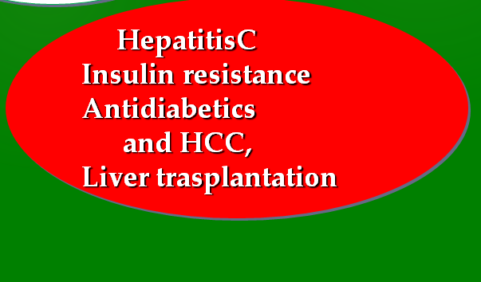

Slide 53
Hepatitis C Infection Facts
United States
HCV is a leading cause of liver disease
HCV accounts for an estimated 1/3 of hepatocellular carcinoma (HCC) cases
HCV is the #1 reason for liver transplant
Approximately 10,000 to 12,000 deaths are attributed to HCV infection annually
  Based on death certificates; likely underestimates
National Institutes of Health. Hepatology. 2002;36(5 suppl 1):S3-20.
Notes:
53
53

Slide 54
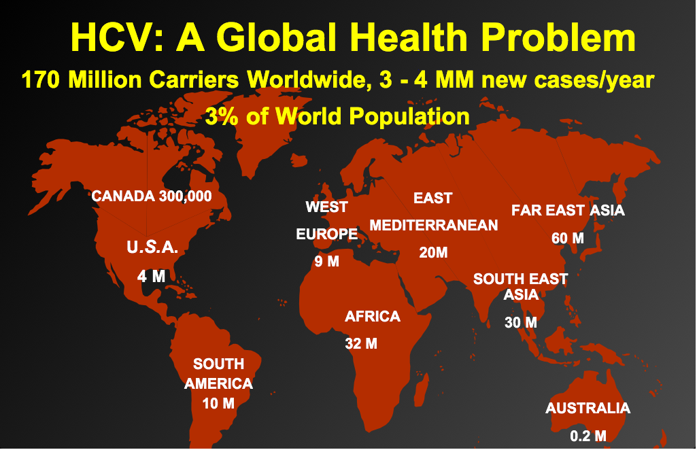

Slide 55
Factors That might Influence
the Outcome of Hepatitis C
Virus
Viral Load
Genotype
Quasispecies
Host
Sex
Age
Race
Genetics
Immune response
Environment
Alcohol
HBV
HIV
Drugs
Steatosis
Iron
NASH-DM
Alberti, J of Hepatology, 1999
Notes:
A number of factors have been shown or suggested to affect the course of chronic hepatitis C and its tendency and rapidity to progress to cirrhosis and to end stage liver disease: greater age at infection (and in several studies also at diagnosis) was associated with increasing histological severity and a more rapid clinical course in most studies. On the other hand, the role of gender remains theoretical as several studies have reported more severe and progressive liver disease in males, but this was not always confirmed. More recent data showed an association between MHC class II alleles and the different outcomes of hepatitis C. Data have not been confirmed in this field and further assessment of the role of genetic factors in determining recovery, chronicity and severity of hepatitis C is needed. The role of the HCV genotype and load is also fairly controversial, with no convincing evidence of more cytopathic strains of HCV. On the other hand, there is more than solid evidence that excessive alcohol intake, as well as coinfection with HBV or HIV, aggravates chronic hepatitis C. Coinfection with HBV significantly increases the risk of development of hepatocellular carcinoma.

Slide 56
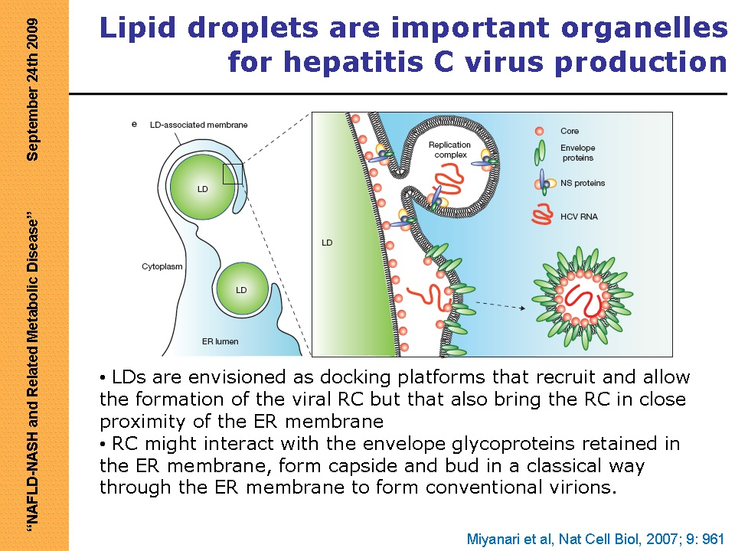

Slide 57
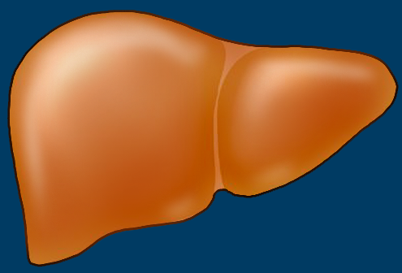

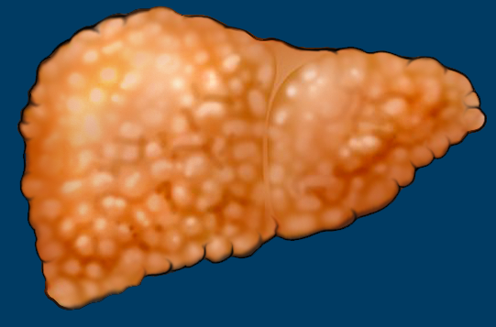
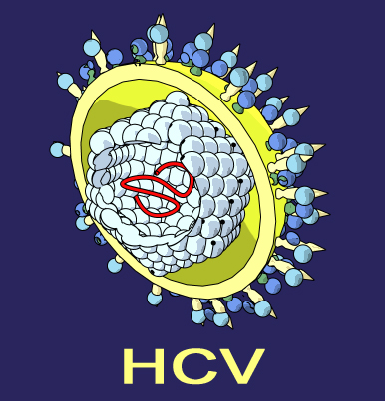
Obesity, Diabetes, Steatosis,
and Nonresponse
Disease
Progression
Response
to
Therapy
SVR
Impact on progression
Impact on the efficacy
of treatment
+
SVR
Graphic courtesy of Dr. Zobair M. Younossi.
HCV graphic courtesy of David Brunelli, MD. http://www.med-ars.it/virus.htm.

Slide 58
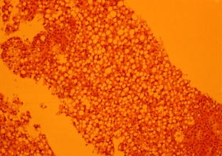
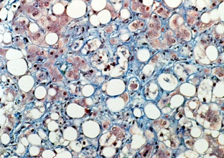
Mechanism—Host-related Metabolic Conditions Contributing to Nonresponse
IR
L
O
W
E
R
S
V
R
+
+
Pro-
inflammatory
adipocytokines
+
Oxidative
stress
-
Biologic
response
to IFN
Increase adipose
tissue
+
Lower interferon
bioavailablity
Graphic courtesy of Dr. Zobair M. Younossi.

Slide 59
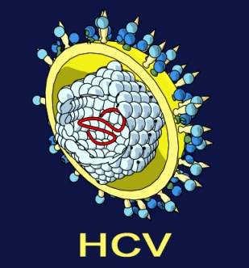
Mechanism—Virus-Related Metabolic Conditions Contributing to Nonresponse
Impaired
IFN
signaling
Lower
SVR
Negative
regulator
STAT-1
(Signal transducer
& activator of
transcription-1)
SOCS-3
(Suppressor of cytokine
signalling-3)
Up-regulates
expression
Impaired
insulin
signaling
Lower
SVR
Promotes
Proteasomal
degradation
of IRS-1
(Insulin receptor
substrate 1)
Graphic courtesy of Dr. Zobair M. Younossi.
HCV graphic courtesy of David Brunelli, MD. http://www.med-ars.it/virus.htm
Notes:
59
HCV Upregulates Expression of SOCS-3

Slide 60
Patrones de respuesta virológica al tratamiento con Peg-IFN/RBV en pacientes con hepatitis crónica C
Peg-IFN/RBV
Recaída
Nula
HCV RNA log (UI/mL)
RVT
Parcial
RVR
Completa
RVC
SVR
Semanas

Slide 61
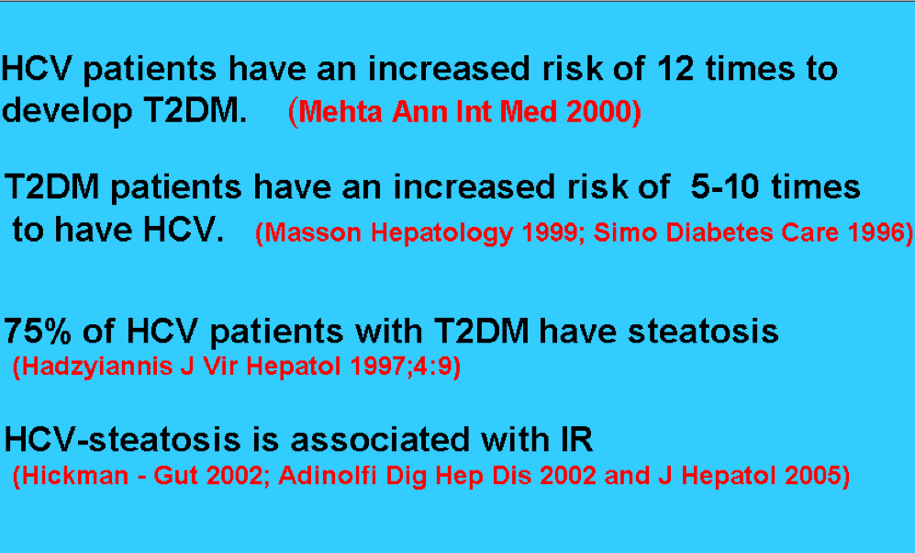
PARTIAL SUMMARY

Slide 62
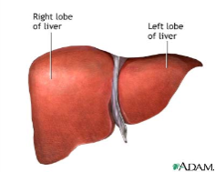
Natural History of Hepatitis C
Annual rate
Cirrhosis 20 %
Decompensation
6%
HCC
4%
Death
≈4%
Hoofnagle, Hepatology, 1997
Di Bisceglie, Hepatology, 2000
UNLESS A NEW LIVER TRASPLANTED
Notes:
Based on studies conducted in the last decade since the publication by Kiyosawa et al., it has become possible to formulate an algorithm of the natural history of hepatitis C using data from a combination of prospective studies of posttransfusion and long-term follow-up of patients with established HCV infection.
Of the 20% of cirrhotic patients, approximately 6% of patients can be expected to develop hepatic decompensation per year , 4% will develop HCC per year, and 3% to 4% per year can be expected to die or require liver transplantation.

Slide 63

This review summarizes the risks and consequences of insulin resistance and PTDM in HCV-positive liver transplant recipients. Risk for developing PTDM is one factor that should be considered when choosing the primary immunosuppressive regimen following liver transplantation
Trasplantation:CsA versus tacrolimus: Diabetogenic effects
Tacrolimus appears to be associated with a higher incidence of PTDM than CsA; this association has been noted in liver transplant recipients and in other transplantation settings, notably renal. One explanation for the greater diabetogenic potential of tacrolimus may lie in a direct effect of insulin-producing β cells of the pancreas .

Slide 64


CONCLUSIONS:
a.-This study shows that DM2 is an independent risk factor for HCC and pre-exists to HCC occurrence. In DM2 patients with Hepatic cirrhosis, metformin therapy is associated with a reduced HCC risk and seems to have a protective effect on HCC development.

Slide 65

CONCLUSIONS:
B.-In fact, metformin treatment may be recommended in diabetic patients with compensated LC not only because its use is not associated with the risk of hypoglycaemia and body weight gain (60) but also because of its potential anti-cancer effects.

Slide 66



EARLY NON INVASIVE DETECTION OF LIVER FIBROSIS

Slide 67
Agenda discussed
Common factors
Liver disease
NASH-DMT2
Management of
cirrhosis and DMT2
HepatitisC
Insulin resistance
Antidiabetics
and HCC,
Liver trasplantation
MANY SIMILAR RECCOMENDATIONS
Notes:
Most risk factors associated with transmission of HCV in the United States were identified in case-control studies conducted between 1978 and 1986. Currently, HCV is rarely transmitted by blood transfusion. Prior to 1992, blood transfusion and organ transplantation were sources of transmission. Since 1985, screening policies have been implemented to exclude blood donors with HIV infection or surrogate markers for non-A, non-B hepatitis, and in 1992, multi-antigen testing of donated blood was instituted. With these measures in place, and with the use of anti-HCV-negative organ and tissue donors, the risk of HCV infection via blood transfusion or organ transplantation has been reduced significantly.
Health care, emergency medical personnel, and public safety workers, such as firefighters, law enforcement officials, and correctional facility personnel, may be exposed to blood in the workplace and become infected with blood-borne pathogens. This may occur by through Accidental needle sticks, during surgery and during childbirth.
Lifestyle chooses are associated with HCV. intravenous drug use, intranasal cocaine use, tattooing with contaminated needles/ink, extensive body piercing, high-risk sexual activity, history of sexually transmitted diseases
A history of military service, especially Vietnam-era veterans has been associated with HCV

Slide 68


Slide 69


Slide 70


Slide 71
Conclusions
Common factors
Liver disease
NASH-DMT2
Management of
cirrhosis and DMT2
HepatitisC
Insulin resistance
Antidiabetics
and HCC,
Liver trasplantation
Notes:
Most risk factors associated with transmission of HCV in the United States were identified in case-control studies conducted between 1978 and 1986. Currently, HCV is rarely transmitted by blood transfusion. Prior to 1992, blood transfusion and organ transplantation were sources of transmission. Since 1985, screening policies have been implemented to exclude blood donors with HIV infection or surrogate markers for non-A, non-B hepatitis, and in 1992, multi-antigen testing of donated blood was instituted. With these measures in place, and with the use of anti-HCV-negative organ and tissue donors, the risk of HCV infection via blood transfusion or organ transplantation has been reduced significantly.
Health care, emergency medical personnel, and public safety workers, such as firefighters, law enforcement officials, and correctional facility personnel, may be exposed to blood in the workplace and become infected with blood-borne pathogens. This may occur by through Accidental needle sticks, during surgery and during childbirth.
Lifestyle chooses are associated with HCV. intravenous drug use, intranasal cocaine use, tattooing with contaminated needles/ink, extensive body piercing, high-risk sexual activity, history of sexually transmitted diseases
A history of military service, especially Vietnam-era veterans has been associated with HCV

Slide 72


Slide 73
Hepatitis C Infection Facts
United States
HCV is a leading cause of liver disease
HCV accounts for an estimated 1/3 of hepatocellular carcinoma (HCC) cases
HCV is the #1 reason for liver transplant
Approximately 10,000 to 12,000 deaths are attributed to HCV infection annually
  Based on death certificates; likely underestimates
National Institutes of Health. Hepatology. 2002;36(5 suppl 1):S3-20.
Notes:
73
73

Slide 74
Insulin Resistance, Obesity, Steatosis, and Nonresponse
Author, Year | Evidenceª | N | SVR (%) | Association with SVR
Kumar D, 2002¹ | II-2 | 62 | G1 (32), G3 (65) | For G3, SVR ↓steatosis
Poynard T, 2003² | II-2 | 1428 | 56 | ↓SVR with steatosis
Bressler B, 2003³ | II-2 | 253 | 42 | ↓SVR with BMI >30 kg/m², G1, and cirrhosis
Sanyal A, 2003⁴ | II-2 | 110 | NA | ↓Response in fatty liver disease
Thomopoulos K, 2005⁵ | II-2 | 116 | 52 | ↓SVR with steatosis, ↑GGT, and G1/4
D’Souza R, 2005⁶ | II-1 | 59 | 56 | ↓SVR with Insulin resistance, ↑fasting insulin, and Asian ethnicity
Harrison S, 2005⁷ | II-2 | 315 | 40 | ↓SVR with steatosis and steatohepatitis
Romero-Gomez M, 2005⁸ | II-2 | 159 | 53 | ↓SVR with insulin resistance, fibrosis, and GI
Camma C, 2006⁹ | II-2 | 291 | NA | ↓SVR with steatosis, fibrosis, and age >50 y
Jian Wu Y, 2006¹⁰ | II-1 | 98 | 57 | ↓SVR with insulin resistance and ↑fasting insulin
Tarantino G, 2006¹¹ | II-2 | 80 | NA | ↓SVR with ↑waist circumference
Conjeeveram HS, 2007¹² | II-1 | 399 | NA | ↓SVR with insulin resistance
Westin J, 2007¹³ | II-1 | 272 | G3: 89; nonG3: 56 | ↓SVR with steatosis in nonG3 only
ªAASLD strength-of-evidence scale. Strader DB, et al. Hepatology. 2004;39:1147-1171.
Graphic courtesy of Dr. Zobair M. Younossi.
Notes:
74
1. Kumar D, et al. Hepatology. 2002;36:1266-1272. 2. Poynard T, et al. Hepatology. 2003;38:75-85. 3. Bressler BL, et al. Hepatology. 2003;38:639-644. 4. Sanyal AJ, et al. Am J Gastroenterol. 2003;98:2064-2071. 5. Thomopoulos KC, et al. Eur J Gastroenterol Hepatol. 2005;17:149-153. 6. D'Souza R, et al. Am J Gastroenterol. 2005;100:1509-1515. 7. Harrison SA, et al. Clin Gastroenterol Hepatol. 2005;3:604-609. 8. Romero-Gómez M, et al. Gastroenterology. 2005;128:636-641. 9. Camm� C, et al. Hepatology. 2006;43:64-71. 10. Jian Wu Y, et al. Liver Int. 2006;26:166-172. 11. Tarantino G, et al. J Gastroenterol Hepatol. 2006;21:1266-1268. 12. Conjeevaram HS, et al. Hepatology. 2007;45:80-87. 13. Westin J, et al. J Viral Hepat. 2007;14:29-35.

Slide 75

Etiopathogenesis

Slide 76


Slide 77

Rev Gastroenterología Mexico 71(4) 453-9
In México among 2500 cases the prevalence of
NAFLD was 14.3 % and Metabolic syndrome 22.8 %

Slide 78



10 yr risk for CVD have lower estimated risk

Slide 79
Liver
Free fattic acid ↑
Oxidation
Reactive oxygen
species ↑
Antioxidation pool ↓
(glutathione)
Cell membrane lipid
Peroxidation ↑
TNF – α ↑
Hepatcyte, kuppfer cell
adipose tissue
Stellate cell
fibrosis
CYP2E1, CYP3A4↑
Peroxidation ↑
oxidative stress

Slide 80

INSULIN RESISTANCE AND PTDM IN
HCV-POSITIVE LIVER TRANSPLANT RECIPIENTS

Slide 81


Slide 82
CONCLUSIONS:
This study shows that DM2 is an independent risk factor for HCC and pre-exists to HCC occurrence. In DM2 patients with HCC, metformin therapy is associated with a reduced HCC risk and seems to have a protective effect on HCC development.

Slide 83



CONCLUSIONES

Slide 84


Slide 85
Treatment of Chronic HCV
Genotype 1 Response Rate
10
9
PEG IFN + RBV THERAPY
SVR
8
1
2
Stopping
Rules
7
6
2%–5%
Log HCV RNA (IU/mL)
Null
5
~29%
4
Partial
27%–43%
3
cEVR
pEVR
68%–72%
2
RVR
~20%
1
88%–91%
0
51%
-6
0
4
8
12
16
20
24
28
32
36
40
44
48
72
Weeks
Detection limit (50 IU/mL)
Abbreviations: EVR, early virologic response; cEVR, complete EVR; pEVR, partial EVR; RVR, rapid virologic response.
1. Jensen DM, et al. Hepatology. 2006;43:954-960. 2. Ghany MG, et al. Hepatology. 2009;49:1335-1374. 3. Fried MW, et al. N Engl J Med. 2002;347:975-982. 4. Manns MP, et al. Lancet. 2001;358:958-965. 5. Davis GL, et al. Hepatology. 2003;38:645-652. Graphic courtesy of Dr. Donald Jensen.

Slide 86


Slide 87
CONCLUSION:
This study showed an elevated prevalence of severe fibrosis in hospitalized diabetic patients, especially patients aged 50 years or older with type 2 diabetes, or with a past history of foot ulcer.

Slide 88
In controlled trials, vegetable protein diets were able to manage patients with chronic PSE (3). During the performance of our own previous double cross-over trial in patients with chronic PSE (4), we observed the appearance of hypoglycemia in several of the cirrhotic-diabetic patients during treatment of PSE with vegetable protein diets. These findings were confirmed later in other ongoing trials with vegetarian diets (5).
Reduction of fasting glucose during vegetarian diets may be due to the presence of high fiber content in vegetable protein diets (6). In fact, recent studies concluded that a fiber diet of several sources improved all aspects of diabetic control (7,8). On the other hand, the association between diabetes and cirrhosis ranges from 4.4% to 12.9% in autopsy statistics and from 7.5% to 34.6% in clinical studies (9). Further, the incidence of diabetes has been reportedly increased in patients with cirrhosis (10). Therefore, a combined dietary-therapeutic treatment is required in patients with both PSE and diabetes.

Slide 89


Slide 90

FIBROSIS

Slide 91

Conslusion: Hypoadiponectinemia is a feature of NASH independent of insulin resistance. Reduced adiponectin level is associated with more extensive necroinflammation and may contribute to the development of necroinflammatory forms of NAFLD.

Slide 92

CONCLUSION:
This study confirms that type 2 diabetes mellitus is an independent risk factor for HCC and pre-exists in the majority of HCC patients. Moreover, in male patients with type 2 diabetes mellitus, our data shows a direct association of HCC with insulin and sulphanylureas treatment and an inverse relationship with metformin therapy.

Slide 93


Slide 94


Slide 95


Slide 96

Hepatitis C Virus
Discovered in 1989 as a small RNA blood-borne virus
Major cause of posttransfusion hepatitis prior to 1992
Major cause of chronic liver disease, cirrhosis, and hepatocellular carcinoma
Worldwide prevalence ranges from 0.5% to 15%
1990-2015: estimated 4-fold increase in the number of patients diagnosed with HCV in the United States
NIH Consensus Development Conference Panel Statement Management of Hepatitis C, 2002
Notes:
In 1989, the hepatitis C virus was identified and found to account for the majority of those patients with non-A, non-B hepatitis.
Transmission from blood products and organ transplants was virtually eliminated by the introduction of a more sensitive test for anti-HCV antibodies in mid-1992.
Although difficult to assess, the incidence of HCV infections declined sharply in the late 80s. Currently, approximately 35,000 new HCV infections conservatively estimated occur each year in the United States.
Because most persons with HCV infection have not yet been diagnosed, but are likely to come to medical attention in the next decade, a four-fold increase in the number of adults diagnosed with HCV infection is projected to increase 4-fold from 1990-2045.

Slide 98
Conclusion: The results of the present study suggest that a high serum concentration of adiponectin is associated with a protective effect against HS.

