Slide 1

EVALUACIÓN DE RECEPTORES EN LA EPILEPSIA DE DIFÍCIL CONTROL: PET vs AUTORRADIOGRAFIA
Dra. Luisa Rocha
Centro de Investigación y de Estudios Avanzados

Slide 2
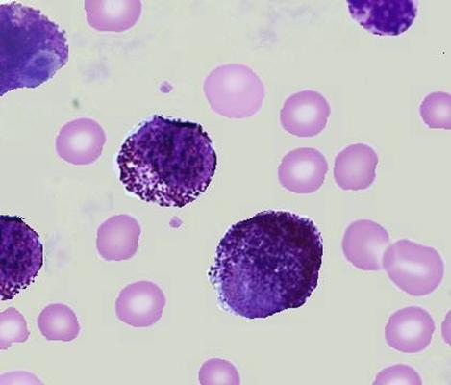
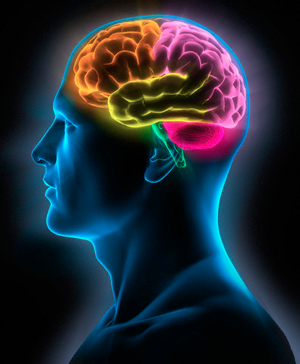
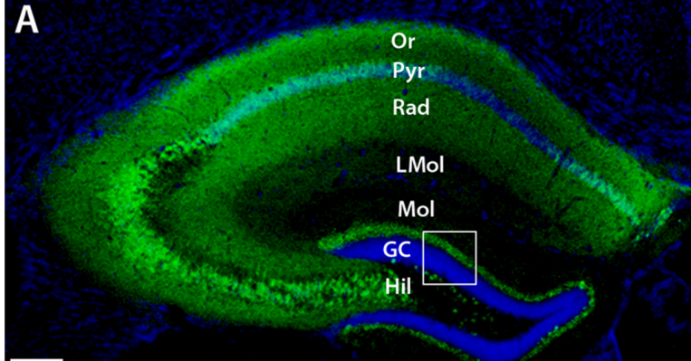
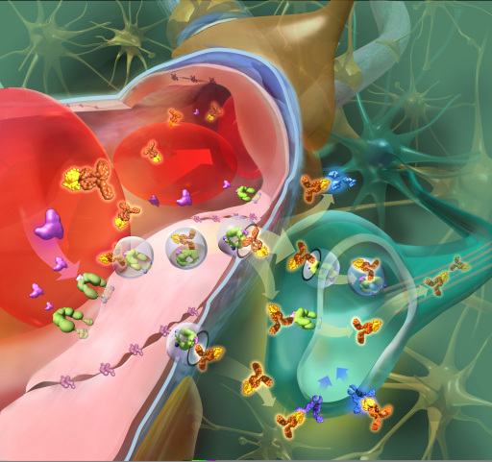

Slide 3
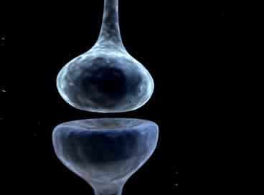

Slide 4
Sistema GABA
Sitio de unión a BDZ

Slide 5
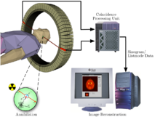
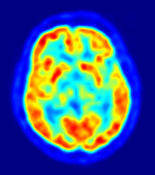
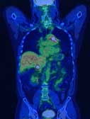
Tomografía de Emisión de Positrones

Slide 6
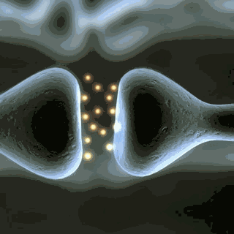



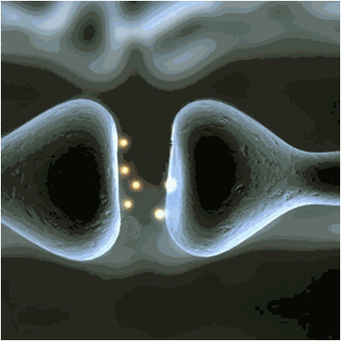

Efectos de la Administración Repetida de Fármacos
Normal
Mayor Unión
Menor Unión
Notes:
6

Slide 7
³H-Muscimol (GABA_{A})
³H-Flunitrazepam (BDZ)
Extrasinápticos
Sinápticos
Inhibición Tónica: receptores GABA_{A} conteniendo subunidades δ y α4
Inhibición fásica: receptores GABA_{A} conteniendo subunidades γ2 y α1-3 (BDZ)

Slide 8
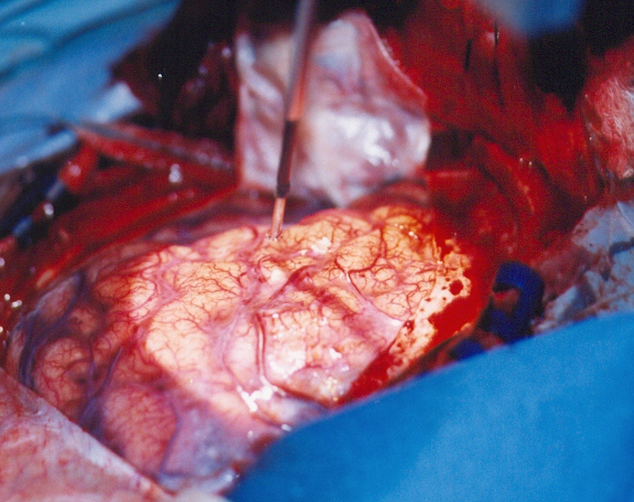
Cirugía de Epilepsia

Slide 9
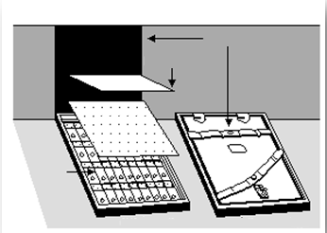
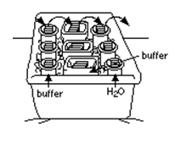



Autorradiografía
4º C
Magazines
Revelado
Secado
Revelador D-11
Fijador rápido
película
Lavado
3 min
30 s
Laminillas
Cubierta película
Análisis de los Resultados
Estándares [¹⁴C] (American Radiolabeled Chemicals)
Película sensible a [³⁵S] (Kodak MR)
[³⁵S]GTPγS
+
Agonista
[³⁵S]GTPγS
GTPγS
Determinación fmol/mg
Bloqueo de la estimulación
Unión inespecífica
Unión Basal
Estimulación
Sim y Childers , 1997

Slide 10
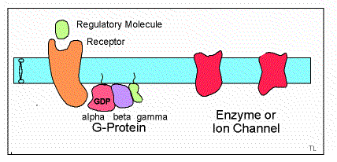
Notes:
Although some studies suggest alterations of mu and NOP receptors as a result of epilepsy, no evidence exist indicating changes in signal transduction mechanisms downstream of the mu opioid and NOP receptors in the human epileptic neocortex.

Slide 11
Receptores a Opioides en Cerebro de Pacientes Epilépticos
Hammers et al., 2007
Notes:
11
In patients with mesial temporal lobe epilepsy (MTLE), positron emission tomography (PET) with specific opiate receptor ligands has revealed a regionally specific increase of opioid receptor availability in the temporal pole ipsilateral to the seizure focus immediately after spontaneous seizures, with a gradual return to basal levels during the interictal period.

Slide 12
Madar et al., 1997
Notes:
12
Interictal PET has revealed increases in both mu and delta opioid receptors in neocortex overlying limbic structures of patients with MTLE. These changes correlates with hypometabolic activity in the same area.

Slide 13
Receptores a Opioides Mu en Cerebro de Pacientes con Epilepsia del Lóbulo Temporal
Notes:
13
All of these evidences led to support that the patients with MTLE present interictal enhanced opioid receptor binding in neocortex. This situation represents a compensatory mechanism that prevents the spread of seizure activity originating in limbic structures.

Slide 15
Receptores Mu en Cx de pacientes con ELT
Autopsia
ELT
Unión a Receptores
+++
Proteínas Gi
---
Notes:
Photomicrographs from Nissl-stained sections (A, D) and distribution of mu opioid bind
^
ing labeled with [3H]DAMGO (B, E) and [35S]GTPγS binding stimulation by DAMGO (C,
F) in neocortical sections of an autopsy sample (A–C) and of a patient with MTLE (D–F). High binding appears as black and gray areas, whereas white areas indicate regions with low
binding. Notice high [3H]DAMGO binding and low [35S]GTPγS binding stimulation by DAMGO in sections of a patient with MTLE. Scale bar=100 μm in A (applies to A–
^
F).

Slide 17
Unión a
receptores Mu
Desacople funcional
del receptor con
la proteína G
Notes:
Although some studies suggest alterations of mu and NOP receptors as a result of epilepsy, no evidence exist indicating changes in signal transduction mechanisms downstream of the mu opioid and NOP receptors in the human epileptic neocortex.

Slide 18
Sim-Selley et al., 2000
Notes:
18

Slide 19
NORMAL
DEPRESION
?
Epilepsia
Pei and Liu., 2010

Slide 20

Ciencias Básicas
Clínica

